Slide 1
It’s Easy To Be Green

Slide 2
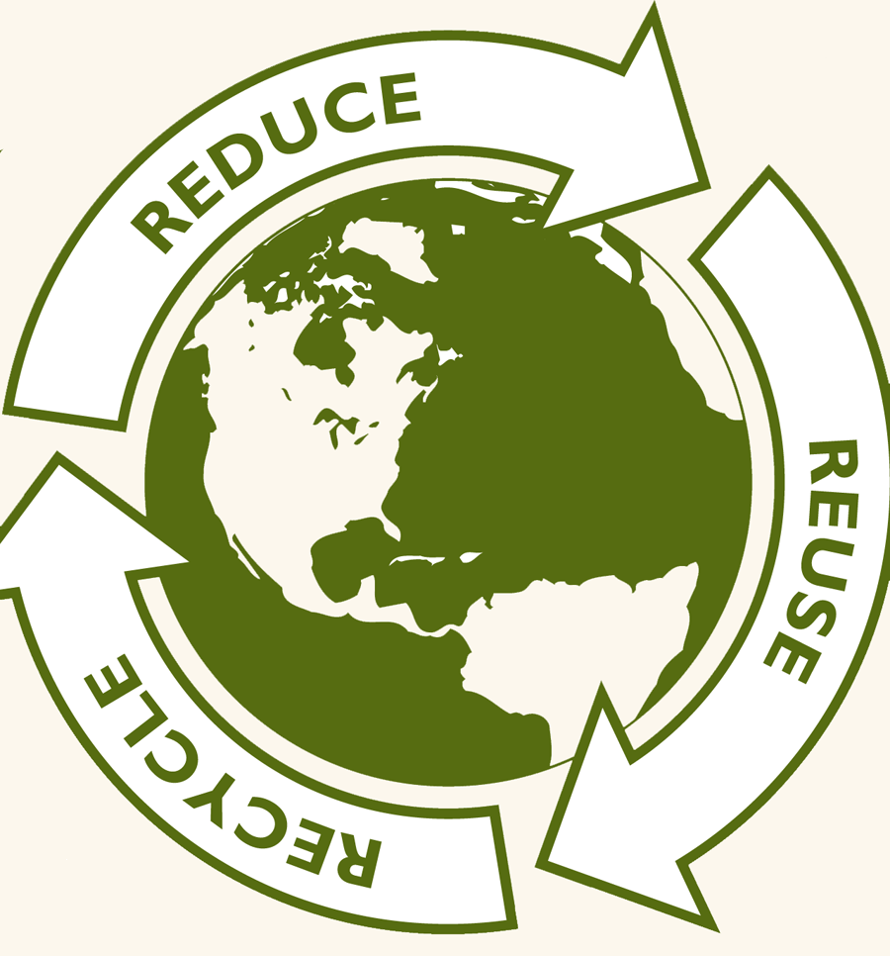

Slide 3
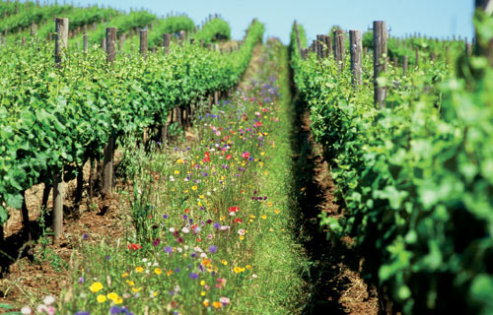
Organic
What does “organic” really mean?
Food grown or produced WITHOUT the use of chemical pesticides or fertilizers
Meat, dairy & eggs without the use of growth hormones or antibiotics
According to USDA regulations, a product called “100 % organic” must contain ALL organic ingredients
If the label just says “organic,” a processed food product can have up to 5 % non-organic ingredients by weight IF those ingredients are on the USDA’s “national list” of approved non-organic ingredients

Slide 4
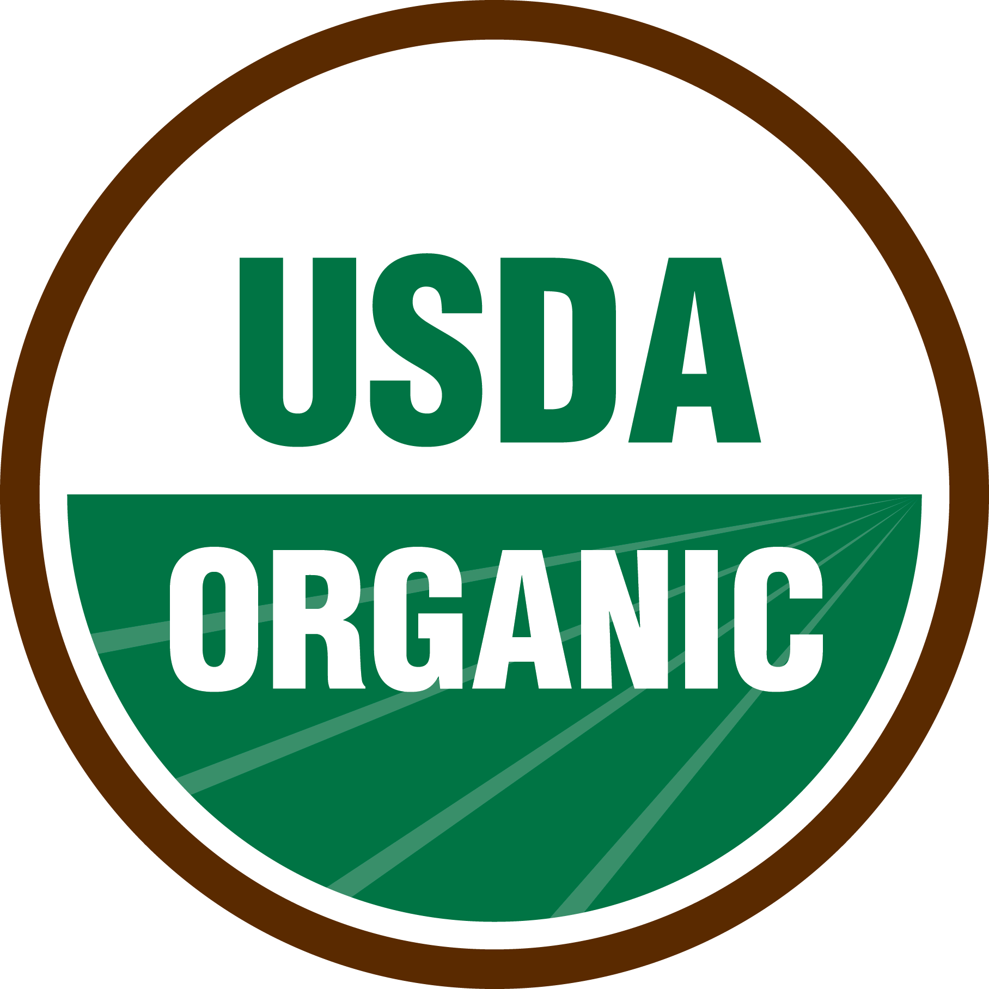

Slide 5
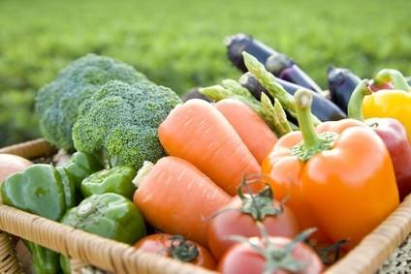
What are the benefits to eating organic foods?
Positive impact to on the earth, the environment and your health
The animals, even being raised for strictly food enjoy a life (no matter how short) that is relatively stress-free, free-grazing on the land
Organic farmers use less energy, less water resources, and NO pesticides
Animals are not crowded, allowed the freedom of movement, and aren’t fed enriched grains or additives to promote quick growth
Organic farmers, live cleanly - Free of pesticides and toxins. They do not clutter up the landfills with toxic waste or subject their bodies to unhealthy foods.

Slide 6
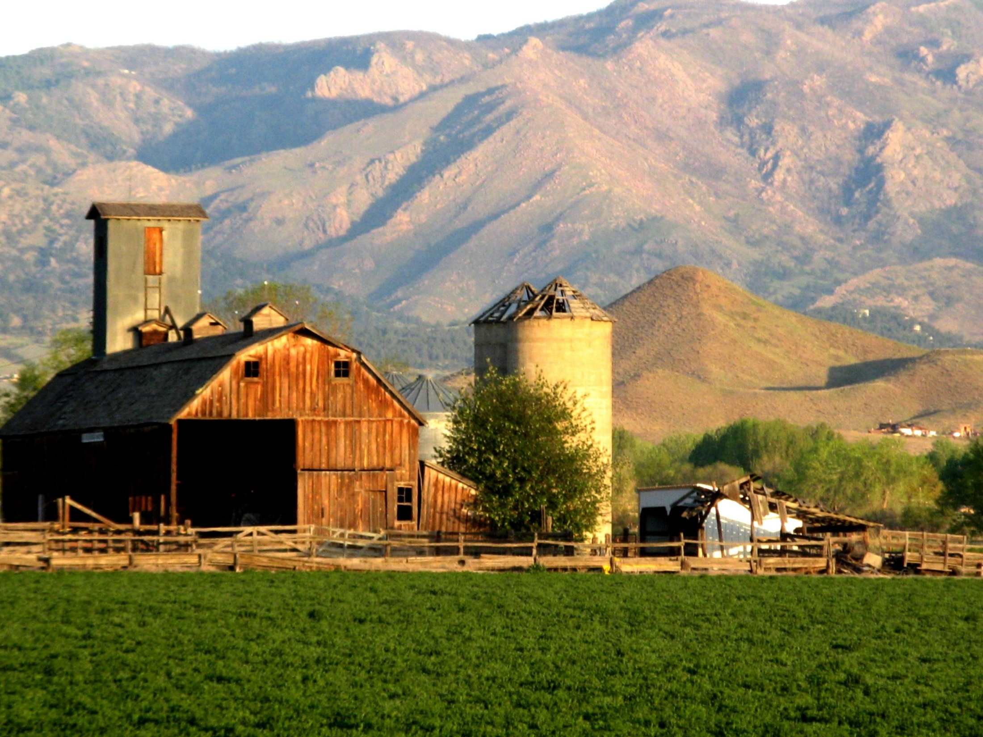
Additional Benefits
Organic Farming is Good for Human Health
Organic Farming is Good for Job Creation
Organic Farming is Good for the Economy
Organic Farming is Good for Soil and Water
Organic Farming is Good for Slowing Climate Change

Slide 7
Risks of Eating Non Organic
Added toxic substances in your food
Exposure to chemicals that have been linked to cancer
The President’s Cancer Panel recommends that American consumers eat food grown without pesticides and synthetic fertilizers

Slide 8
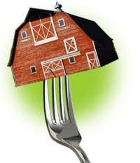
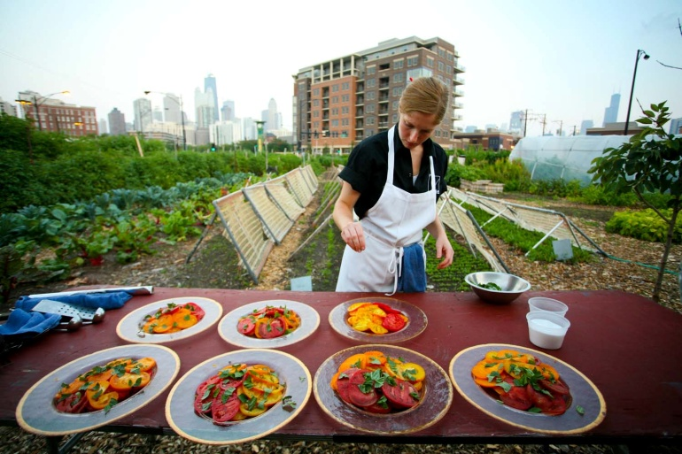
Farm-To-Table
Food ingredients are sourced as locally as possible
This means the food is fresher
because it travels less distance
and that less people handle the food
Food sold at farmer’s markets has usually been picked that day
Food is more nutritious when fresh

Slide 9
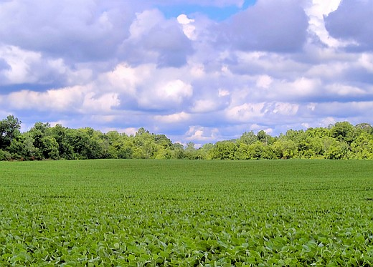
Farm-To-Table
Community-based agriculture has the potential for creating jobs, developing small business entrepreneurships and keeping MONEY in the community
Eating Locally Grown Food
Helps the Local Economy

Slide 10
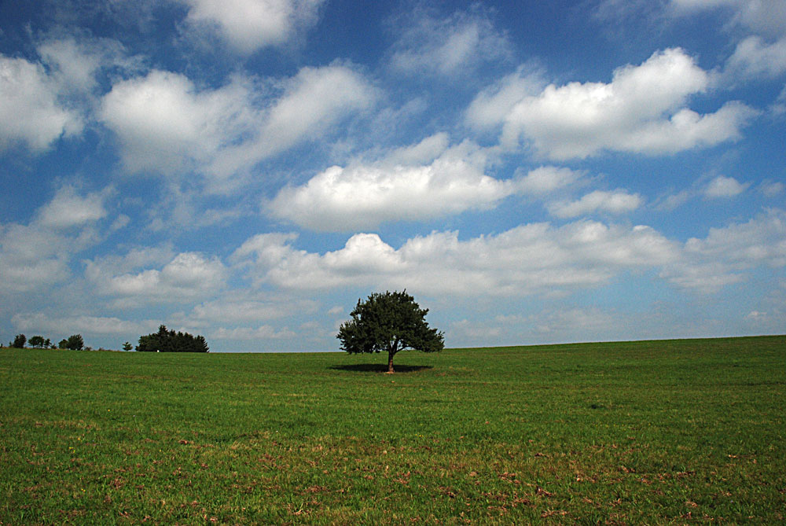
Composting
The natural decaying or rotting process in nature
Requires organic waste, soil, water and air to work
Process of decomposing can take 2-3 weeks or up to many months
Creates nutrient-rich compounds that promote growth
Used as a natural fertilizer in gardens or for farming

Slide 11
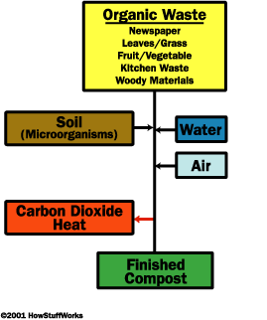

Slide 12
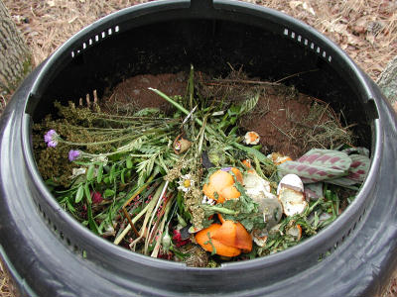
Items that can be composted
Kitchen waste - best to chop up or grind the wastes so that they can be broken down faster
Fruit and vegetable wastes - peels, skins, seeds, leaves
Egg shells
Coffee grounds (including paper filters), tea bags, used paper napkins
Corncobs - should be shredded to make them break down quickly
Meat/dairy products Yard waste
Grass clippings - Some grass is okay
Leaves
Pine needles
Weeds
Woody materials (branches, twigs)
Straw or hay
Newspaper
Seaweed, kelp or marsh grass hay - rinsed 1st
Sawdust - This is an excellent source of carbon.

Slide 13
Why Composting is Good…
Reduces the amount of solid waste you produce = less stuff in landfills
Saves you tax $$$
It creates an environmentally friendly fertilizer
(better than synthetic or man-made versions)

Slide 14
Links
http://www.wisegeek.com/what-is-a-farm-to-table-restaurant.htm
http://www.farmtotableonline.org/about/
http://www.farmtotablenm.org/fts/local-organic-food-farming-can-help-revitalize-the-
economy/
http://melissa-nykorchuk.suite101.com/from-farm-to-table-a218580
http://organic.lovetoknow.com/health-benefits-of-organic-food-and-enviornment
http://ofrf.org/publications/organicfarmingforhealthandprosperity.pdf
http://home.howstuffworks.com/composting1.htm

