Slide 1
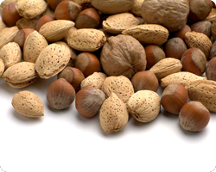
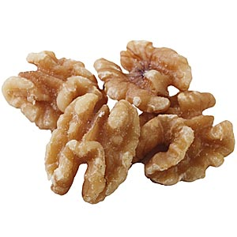
Tree Nut Allergy By: Dawn DiMarco

Slide 2
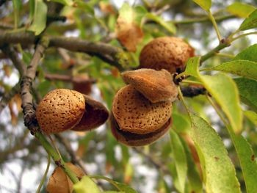
What is a Tree Nut Allergy?
A tree nut allergy is one of the most common allergies in the United States.
It’s a hypersensitivity to dietary substances from tree nuts causing an overreaction from the immune system.

Slide 3
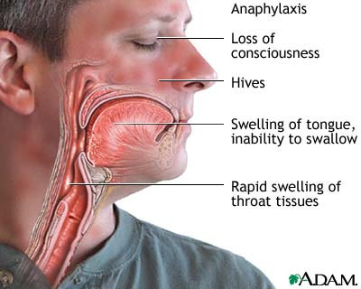
Life Threatening?
YES! It overreacts the immune system which may cause the throat to close, which causing lack of breathing.

Slide 4
http://medicineworld.org/medince/allergy/allergy-statistics.html
Approximately
0.6%
of Americans suffer from a tree nut allergy.

Slide 5
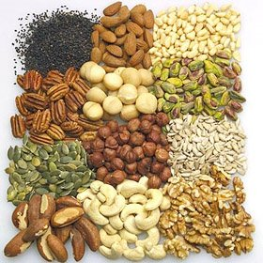
Dietary Restrictions
Cashews
Pecans
Almonds
Walnuts
Brazil Nuts
Filbert
Macadamia
Coconut
Hazelnut

Slide 6
How to Avoid?
Always read labels on food products.
Make sure restaurants you visit are aware of your food allergy before you order your food.
Always carry an EpiPen on your person at all times.

Slide 7
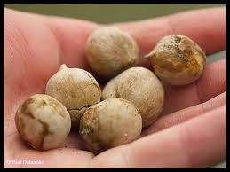
Interesting Facts
Only 9% of children out grow a tree nut allergy.
Peanuts and Seeds are not a restriction and are commonly confused for tree nuts.
Some unexpected sources of tree nuts are :
Barbeque sauce
Pancakes
Pasta
Pie Crust
Honey
Salad

